Slide 1
Alternatives to Seclusion and Restraint
Karin Tochkov, Ph.D.
&
Nichole Williams, B.S.

Slide 2
Seclusion:
locking a patient alone in a room that he/she cannot leave without assistance of staff
Restraint:
mechanically tying a patient to a bed using softened leather straps
Notes:
(Kuivalainen et al., 2017)

Slide 3
Seclusion & Restraint
Last resort
Patient may be a danger to himself or others
No therapeutic value
Can cause emotional and physical harm and in some cases death
Seclusion exacerbates suffering
Notes:
In some rare situations it may be appropriate to use seclusion or restraint, such as when a patient may attempt to harm himself or others. In most cases, however, seclusion and restraint should be used only as a last resort (Kuivalainen et al., 2017). According to the MHA (2017), seclusion and restraint have no therapeutic value and can cause physical and emotional harm to patients. Oftentimes, seclusion only exacerbates and unnecessarily prolongs patient suffering. This is especially true in patients that have previously experienced a trauma (MHA, 2017).

Slide 4
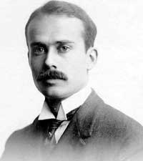
Founder of the National Committee for Mental Hygiene
“Is it not, then, an atrocious anomaly that the treatment often meted out to insane persons is the very treatment that would deprive some sane persons of their reason?”
- Clifford W. Beers, A Mind that Found Itself
Notes:
The quotation refers to seclusion and restraint which Beers experienced during his time as a mental health patient. Horrified by the abuses, Beers founded the NCMH in 1909 which later evolved into Mental Health America (MHA, 2017).

Slide 5
Seclusion and Restraint in Psychiatry
Often used even without signs of potential violence
Used to control agitation or disorientation; used to control challenging behavior
Against theoretical and legal ground already established
Lack of evidence supporting use
Does not alleviate mental illness or reduce aggressive behavior

Slide 6
Kontio et al. (2012)
Found patient experiences of seclusion and restraint to be mostly negative
Feelings of anger, helplessness, powerlessness, confusion, loneliness, desolation, humiliation
Many patient do not know the reason why they are placed in seclusion or restraints
Patient suggestions to improve seclusion/restraint:
Use of toilet/hygiene needs
More comfortable furnishings
Smoking provisions
Ordinary clothing
Notes:
Kontio et al. (2012) used open-ended focused interview questions to explore patients’ experiences with seclusion and restraint. It was found that patients were often not debriefed about why the experience occurred and were not told how to avoid such an experience in the future. Sometimes, while in seclusion or restraints, basic needs such as washing, toileting, eating, and drinking were not met. There was a lack of meaningful activities (reading, music, exercise) while patient was placed in seclusion or restraints (Kontio et al., 2012).

Slide 7
Alternatives
De-escalation
Safewards model
Sensory approaches

Slide 8
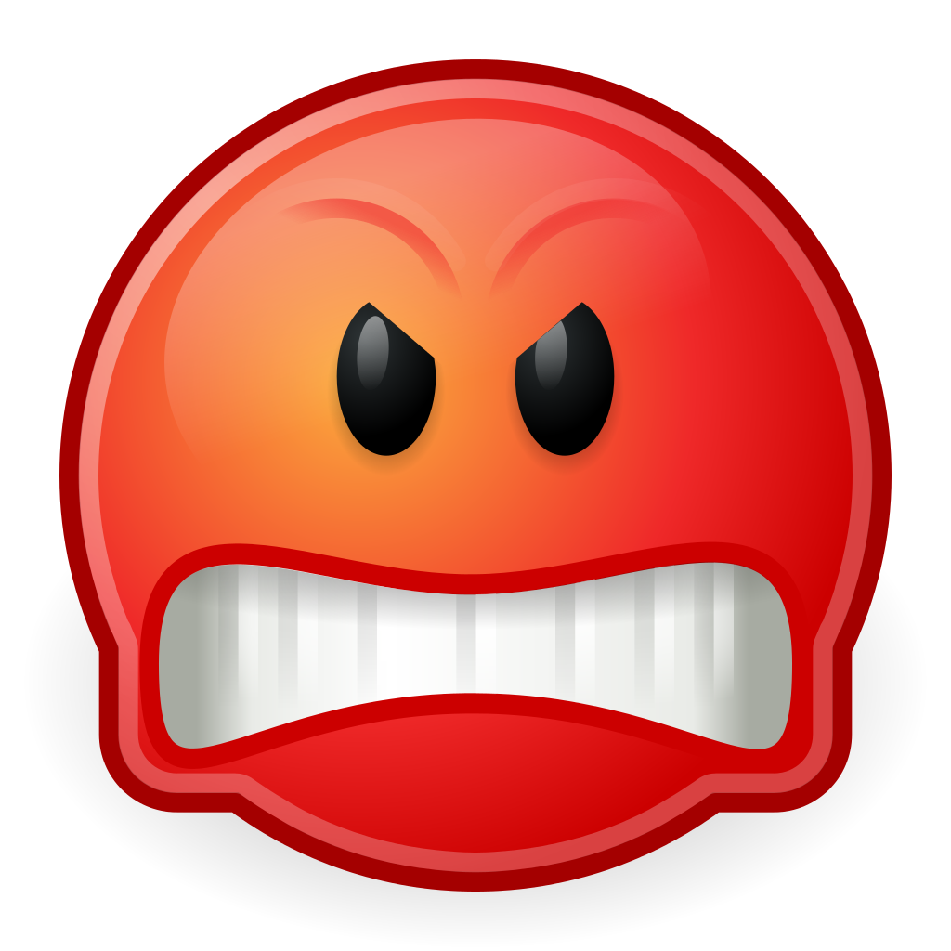
De-escalation
Techniques used to help patients manage emotions and quell violent tendencies
Recognize the warning signs: agitation, anger, aggression
Interact with patient; Offer choices in difficult situations
Goal: redirect patient to a calmer state
This Photo by Unknown Author is licensed under CC BY-SA

Slide 9
Bowers’ Model of De-escalation
Delimit
Clarify
Resolve
Notes:
Delimit
Make immediate situation safe
Activating alarm system, securing backup, getting other patients out of the way, moving patient of concern to a quiet area
Clarify
Find out what is upsetting patient (Ask “What’s the matter? What’s upsetting you?”)
Offer help
Help patient with orientation: remind them who you are, where they are, etc.
Sort out confusion, speak clearly, check your understanding of the situation
Resolve
Try to find a way to deal with patient complaint
Suggest various courses of action/choices
Be flexible when able; if you cannot be flexible then explain reasoning behind rules
Actively listen to patient
Control anxiety or frustration – do not let these feelings be communicated to the patient. Amplify respect and empathy.

Slide 10
Conflict: patient behaviors that can result in harm
Containment: methods that staff use to control difficulties
Flashpoint: situation where things could go wrong
Originating domains: aspects known to create flashpoints
Notes:
The safewards model identifies aspects of inpatient treatment that lead to conflict and containment. The safewards model attempts to introduce preventative measures and encourages staff to modify their behavior so as to avoid the use of seclusion or restriction. By educating staff about the presence of conflict and containment in certain domains, staff may be more able to successfully navigate difficult situations which may lead to a reduction in the use of seclusion and restraint.
Examples of conflict: violence, suicide, acts of self-harm, alcohol/drug use, absconding
Examples of containment: extra medication, increased monitoring/observation, restriction

Slide 11
Safewards Model: Originating Domains
Staff Team or Internal Structure Domain
Physical Environment Domain
Outside Hospital Domain
Patient Community Domain
Patient Characteristics Domain
Regulatory Framework Domain
Notes:
Staff modifier: how staff manages patients and their environments; how staff interacts and responds to patients
- Staff behavior influences how often conflict and containment occur
1. Staff Team or Internal Structure Domain
This domain is concerned with how the staff deals with their own feelings. The domain also focuses on the consistency of rules and consistency of patient treatment. An example of a flashpoint within this domain might be a staff member limiting a patient’s behavior. Staff may modify this situation by showing compassion and choosing the appropriate time to address patient behavior
2. Physical Environment Domain
Focuses on the environment of the ward which may include furniture, equipment, and décor. The more comfortable patients feel in a setting, the less likely conflict will arise. Also concerns patient privacy. A flashpoint within this domain might occur when a patient feels threatened by a locked door. Staff may modify the situation by checking in with the patient often.
3. Outside Hospital Domain
Concerns outside world. Patients have family and friends. They may have access to alcohol and drugs outside of the ward. Patients are aware that the outside world exists and they will eventually have to return to it. Flashpoint: patient dealing with divorce, bereavement, illness, loss. Staff modifier: staff should be aware of issues that patient has outside the ward.
4. Patient Community Domain
Tensions between patients. Flashpoint: patient might find it difficult to deal with another patient’s behavior. Staff modifier: Staff can model caring and understanding. Give patients a chance to support one another.
5. Patient Characteristics Domain
Certain patient characteristics are more likely to lead to conflict: patients with paranoia or those who suffer from hallucinations; patients with interpersonal difficulties; patients of a certain gender, age, or diagnosis. Flashpoint: staff places restrictions on patient. Staff modifier: staff offers explanations.
6. Regulatory Framework Domain
Laws and policies. Flashpoint: Patient feels as if staff is abusing power. Staff modifier: Ensuring patient rights are respected and looked after.
Goal: Staff modifies behavior to create positive and empathetic atmosphere. Patients are respected and cared for. Attempt to minimize staff anxiety and frustration so that patients respond in kind. When staff has the ability to regulate their own emotions, they can more easily adapt and control situations. Staff frustrations and anger incite patient frustration and anger. Increases teamwork and consistency among staff members.

Slide 12
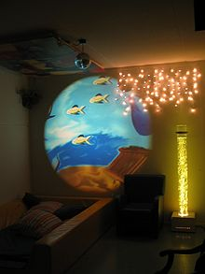
Sensory Approaches
Sensory diet
Coined by Wilbarger (1984)
An individual’s preferred sensorimotor experiences
Can be relaxing/calming or allow individual to be more alert
Multisensory treatment rooms
Notes:
A sensory diet is comprised of sensorimotor experiences which allow an individual to “function optimally within their environment (Champagne, 2004).” Those with mental health issues or who have experienced trauma may have a difficult time identifying the sensorimotor experiences which might help to calm them in stressful situations. Practitioners can help patients identify certain experiences/activities that could aid the patient in future self-organization or in the regulation of their emotions. Not all activities need to be calming. In fact, some patients may benefit more from activities which are stimulating and make them more alert to their surroundings. For example, a patient might prefer exercising or cleaning over listening to classical music or rocking in a chair (Champagne, 2004).
Multisensory rooms are used in individual or group sessions. These rooms allow access to a variety of sensorimotor activities. In a study conducted by Champagne & Sayer (2003), 89% of multisensory room sessions were reported to have a positive effect on the patient (Champagne, 2004). The incidence of seclusion and restraint was reduced by 54% during the year that the multisensory room was in use (Champagne & Sayer, 2003 as cited in Champagne, 2004).

Slide 13
Pennsylvania State Hospital System Makes Changes
Seclusion and restraint used as a last resort
Staff must try to end seclusion or restraint as quickly as possible
“Do-Not-Restrain” list (medical/psychiatric conditions)
When restrained, patient cannot be left alone
Chemical restraints are prohibited
Follow-up with patient after use of seclusion or restraint
Family members notified
Staff is trained in de-escalationMonthly reports on hospital and system use of these procedures
Psychiatric Emergency Response Teams (PERT)

Slide 14
Pennsylvania State Hospital System
Worldwide leader in reducing use of seclusion and restraint
By 2000, reduced by 74% in 9 state hospitals
From 2014 to 2015, restraints were only used 10 times
Seclusion not used since 2013
Patient-to-patient and patient-to-staff assaults have declined

Slide 15
South Carolina Study
Changing physical environment
Repainting walls – warmer colors
Decorative throw rugs
Rearranging furniture to encourage positive patient-to-patient and patient-to-staff interaction
Replacing worn-out furniture
Making language in rules and signage less restrictive
Associated with significant reduction in seclusion and restraint

Slide 16
Mental Health America Suggests…
Voluntary time-out, comfort rooms
Debriefing session for everyone involved (staff debrief separate from family and patient debrief)
Staff training every 6 months (emphasis on non-violent approaches)
Consider age, gender, development, clinical history of patient
Physical environment is an important tool

Slide 17
References
Bowers, L. (2014). A model of de-escalation. Mental Health Practice (2014+), 17(9), 36. doi:http://dx.doi.org.proxy.tamuc.edu/10.7748/mhp.17.9.36.e924
Bowers, L. (2014). Safewards: a new model of conflict and containment on psychiatric wards. Journal of Psychiatric and Mental Health Nursing, 21(6), 499–508. http://doi.org/10.1111/jpm.12129
Champagne, Tina,M.Ed, O.T.R./L., & Stromberg, Nan, MSN,R.N., C.S. (2004). Sensory approaches in inpatient psychiatric settings: Innovative alternatives to seclusion & restraint. Journal of Psychosocial Nursing & Mental Health Services, 42(9), 34-44. Retrieved from https://login.proxy.tamuc.edu/login?url=https://search-proquest-com.proxy.tamuc.edu/docview/225551605?accountid=7083
DBSAlliance. (2015, July 6). Understanding agitation: De-escalation. Retrieved from https://www.youtube.com/watch?v=6B9Kqg6jFeI
Gal, Darren. (2017, October 3). Seclusion and restraint in NSW mental health units. Retrieved from www.youtube.com/watch?v=RI4aEj9Tjzs.
Kontio, R., Joffe, G., Putkonen, H., Kuosmanen, L., Hane, K., Holi, M., & Välimäki, M. (2011). Seclusion and restraint in psychiatry: patients experiences and practical suggestions on how to improve practices and use alternatives. Perspectives in Psychiatric Care, 48(1), 16-24. doi:10.1111/j.1744-6163.2010.00301.x
Kuivalainen, S., Vehviläinen-Julkunen, K., Louheranta, O., Putkonen, A., Repo-Tiihonen, E., & Tiihonen, J. (2017). De-escalation techniques used, and reasons for seclusion and restraint, in a forensic psychiatric hospital. International Journal of Mental Health Nursing, 26(5), 513-524. doi:10.1111/inm.12389
Mental Health America. (2017, August 21). Position statement 24: seclusion and restraints. Retrieved from http://www.mentalhealthamerica.net/positions/seclusion-restraints#9
Safewards. (2018). Safewards: an introduction. Retrieved from http://www.safewards.net/model/model-diagram
Tochkov, K. & Williams, N. (2018). Patient or prisoner? Forced treatment for the severely mentally ill: life-long implications for patients who have been treated against their will. Ethical Human Psychology and Psychiatry, 20(1), 56-68. http://dx.doi.org/10.1891/1559-4343.20.1.56

